Slide 1
Leisure Goals
DATA 211 Project
Zachary Farmer

Slide 2
Data Set
Description: Time spent (in minutes) playing video games and reading fiction, non-fiction, and comics
Collection Process: Manual, timed with a stopwatch
Period: 4/01/22 - 4/15/22
Notes:
As I thought about this project, I knew that I wanted to take a look at my free time. I don’t have a lot of it these days, so I thought it would be valuable to gain some insight on it. That said, my main two leisure activities are playing video games and reading. When I started collecting my data, I wasn’t too sure exactly what question I wanted to answer, so I chose to be as specific in my collection as possible to start. I split my reading into 3 categories: fiction, non-fiction, and comics. Additionally, I also tracked the time I spent playing video games.
To collect this data, I went with a tried-and-true method, the stopwatch. Whenever I was about to start reading or gaming, I would pull out my phone’s Clock app and start the stopwatch, and then I would pause the stopwatch when I was done. This may not have been the most elegant method, but it allowed me to be accurate with my time tracking. I tracked this data from April 1st through April 15th, a total of 15 days worth of data on my leisure activities.

Slide 3
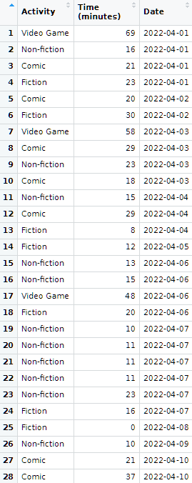
Data Set
Data Set Name:
reading_gaming
Variables:
Activity
Categorical
Time (minutes)
Numeric
Date
Categorical
Notes:
On this next slide, we can see a screenshot showing the first 28 individuals in my data set. The data set was named simply “reading_gaming”, and there are three variables: Activity, Time (measured in minutes), and Date.
Activity is a categorical variable, which consists of the 4 categories I listed on the previous slide: Video Game, Fiction, Non-fiction, and Comic.
Time is a numeric variable that simply lists out the total minutes spent on the activity in a single session. I decided to use whole numbers for this column. In my data collection I would round up if I was 30-seconds or more through the current minute and round down if I was under 30-seconds through the minute.
My last variable is Date, which I have listed here as a categorical variable. I decided this was categorical, since I would use it to group data later on in my analysis. This grouping by date will be very important in testing my hypothesis, as we’ll see shortly.

Slide 4

Question to be Tested
Is the average amount of leisure time I spend reading per day greater than 30 minutes?
H0: μ_reading = 30
Ha: μ_reading > 30
Notes:
Finally, we come to my hypothesis, or question, to be tested. I decided upon this question about halfway through my collection process, as I noticed how inconsistent my leisure time was from day to day. Since reading is very important to me, I decided to focus my question on how much time I have actually been able to devote to it. I landed upon my question: Is the average amount of leisure time I spend reading per day greater than 30 minutes.
We can see on the bottom-left side of my slide that I identified my null hypothesis as mu of reading is equal to 30 and my alternative hypothesis as mu of reading is greater than 30.

Slide 5
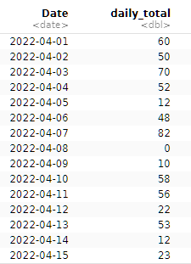

Data Wrangling
?
Is there missing data?
On 4/08/22, I didn’t spend any time reading. I needed to add a data point to reflect this in my daily average.
How do I total my reading time?
I need to filter out the video game time, group by date, and find the daily sum of time spent reading. This data will be stored in a list as “daily_reading”.
Notes:
After gathering all of my data, I needed to do some data wrangling before testing my hypothesis. There were two main questions I had to ask: Is there missing data? And how do I total my reading time?
Regarding the missing data question, when I first started looking at the data, I noticed that I didn’t read or game at all on April 8th. I decided that the type of reading I recorded wouldn’t affect my calculations at all, so I added a data point to reflect 0 time spent reading on that date.
For my second question, I had to put a bit more thought into the answer. Since I didn’t need the gaming data and my reading data was separated into three separate categories, I needed to think back to our data wrangling lesson and use some of what I learned there. On the bottom-right, we can see the code I landed on. First, I used the filter function to filter out gaming time. Then, I piped that into a group_by() function to group the reading data by date, and finally I added a summarize function to sum up the total time spent reading on each date. I stored this data in a list called daily_reading, which we can now see above my code.

Slide 6
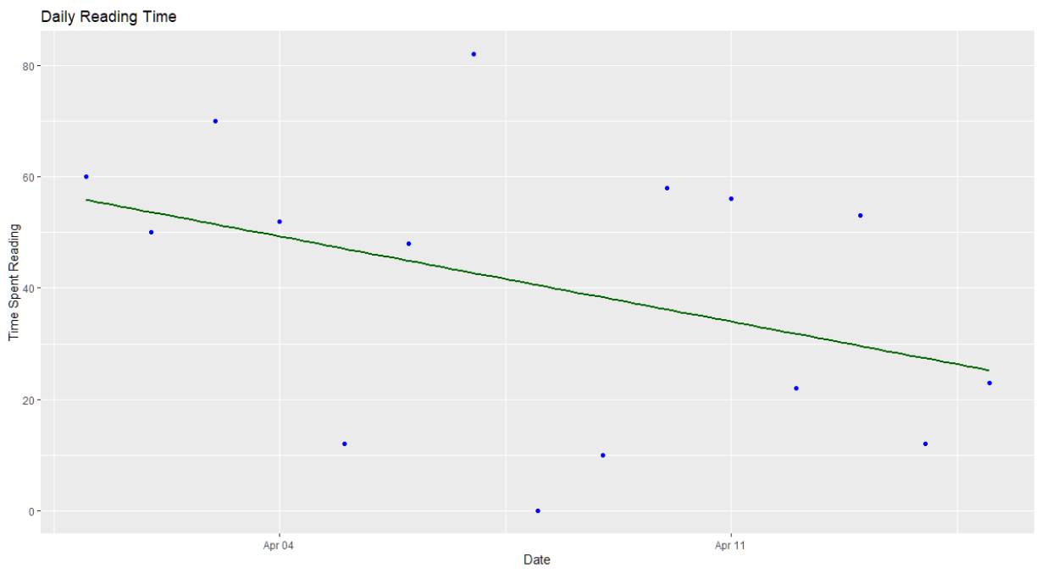
Scatter Plot w/ Regression
Regression line is a weak fit to the data
Notes:
From there, I was curious to see my daily_reading data displayed visually. I used ggplot to make a scatter plot of the data, and I decided to include a regression line in my graph. It looked like my time spent reading per day did trend down slightly throughout the 15 days, and the regression line showed that, but it didn’t look to me like a particularly strong fit. I decided to put some numbers to that, so I used the lm() and summary() functions, as we see on the bottom left. In the output, the R-squared value was calculated as 0.152, which backs up my instinct that the regression line was a weak fit to the data.

Slide 7
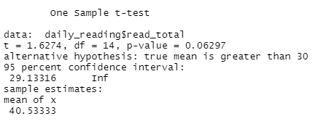
T-Test
t.test(daily_reading$read_total, mu=30, alternative="greater")
Notes:
Finally, it was time actually test my hypothesis. I used a t.test on my daily_reading data, and it showed a few things. First, my sample mean was 40.53, so I did actually read for more than 30 minutes per day on average during the data collection period. However, the p-value is more important to answer my question of whether I read more than 30 minutes every day. That p-value was calculated as 0.062.

Slide 8
Conclusion
Fail to reject H0!
There is not sufficient evidence to support the claim that my average daily time spent reading for pleasure is greater than 30 minutes.
Notes:
In conclusion, since my p-value of 0.062 was greater than 0.05, I fail to reject the null hypothesis. There is not sufficient evidence to support the claim that my average daily time spent reading for pleasure is greater than 30 minutes. That conclusion brings me back to the title of this presentation, leisure goals…

Slide 9
What is my leisure goal? Find more time to read!
Notes:
What is my leisure goal? Find more time to read!

Slide 10
Portfolio
You can find this project in my DataScienceDegree repository on GitHub!
https://github.com/DoctorFarmer/DataScienceDegree
Notes:
That brings me to the end of the presentation. My last slide here has a link to and the URL for my Github repository. Thank you all for your time and attention.

